Slide 1
SESSION 7 | GEND | THE INSTRUCTION CHAIN
From a Gene Instruction to a Cell Behavior
How can a change in DNA affect a developmental process without changing every cell in the body?
Genes do not act alone or act as destiny. Their protein products participate in cell behaviors that must occur in the right place and time.
Truths 1 and 4: Gene expression guides developmental decisions, and disrupted regulation can change a process.
Craniofacial Research Track | John Hay Biomedical
1/13

Slide 2
SESSION 7 | GEND | THE INSTRUCTION CHAIN
Carry the previous idea forward
Yesterday's takeaway: fusion is an active remodeling process with a narrow window.
Today we use that idea to answer one deeper question.
Bring yesterday forward before adding new details
2/13

Slide 3
SESSION 7 | GEND | THE INSTRUCTION CHAIN
Our unit has four truths to return to
1. Cells differentiate
2. Development sculpts
3. Cells move
4. Dysregulation changes outcomes
Truths 1 and 4: Gene expression guides developmental decisions, and disrupted regulation can change a process.
The four durable truths of developmental biology
3/13

Slide 4
SESSION 7 | GEND | THE INSTRUCTION CHAIN
Today's take-home
Genes do not act alone or act as destiny. Their protein products participate in cell behaviors that must occur in the right place and time.
DNA instruction
RNA message
Protein tool
Cell behavior
Developmental outcome
Say this aloud: Genes do not act alone or act as destiny. Their protein products participate in cell behaviors that must occur in the right place and time.
Daily graphical abstract
4/13

Slide 5
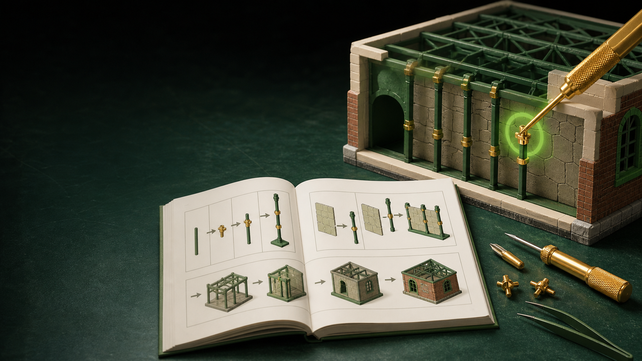
SESSION 7 | GEND | THE INSTRUCTION CHAIN
Study the a construction manual
Do not name the biology yet. Describe only what you see.
Analogy picture: observe before explaining
5/13

Slide 6
SESSION 7 | GEND | THE INSTRUCTION CHAIN
What does the picture make you notice?
• What has to happen between a manual and a finished tool?
• Why would the same manual have different effects at different job sites?
• What could go wrong even if the manual itself is present?
Teacher move: collect observations first. Delay the biological vocabulary until students state the pattern.
Socratic inquiry: students create the rule
6/13

Slide 7
SESSION 7 | GEND | THE INSTRUCTION CHAIN
Turn your observations into rules
• An instruction must be read and converted into a working tool.
• The tool must be used in the right cell, place, and time.
• A changed instruction can alter a process without determining every outcome.
Now name the analogy. Ask students to defend each rule with a detail from the picture.
Socratic inquiry: name the rule together
7/13

Slide 8
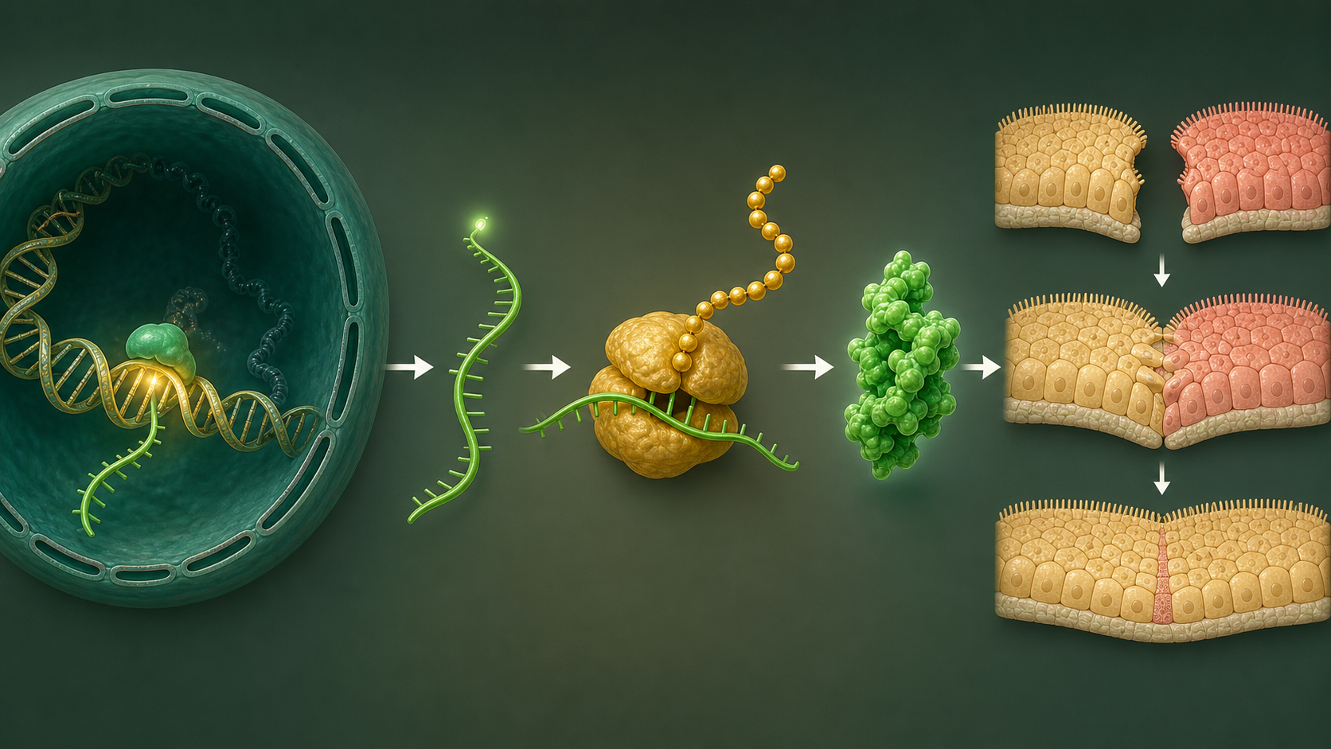
SESSION 7 | GEND | THE INSTRUCTION CHAIN
Real biology question: how does an IRF6 variant become a cell-behavior question?
• IRF6 DNA is transcribed to RNA and translated to a protein that contributes to epithelial and periderm cell behavior.
• A variant can alter protein function, but a developmental outcome also depends on cell type, timing, other genes, and environment.
• This is why scientists separate a plausible mechanism from a conclusion about a person.
This is a real mechanism. The claim stays matched to the evidence, not to an assumed patient diagnosis.
Real biology: the analogy becomes a research question
8/13

Slide 9
SESSION 7 | GEND | THE INSTRUCTION CHAIN
Map the analogy onto the biology
Manual
DNA sequence of a gene such as IRF6
Finished tool
The IRF6 protein
Correct job site and time
Epithelial cells during a fusion window
Label transfer: each biology step has an analogy step
9/13

Slide 10
SESSION 7 | GEND | THE INSTRUCTION CHAIN
Your team has to make a call
SITUATION
A lab finds an IRF6 variant that changes a protein region. In a cell model, the altered protein cannot support normal periderm behavior. Which claim is supported: A. the variant guarantees a cleft in every person, B. the variant is a plausible mechanism worth testing in developmental models, C. no other evidence is needed?
Require a claim, the evidence in the situation, and reasoning that uses today's analogy rule.
Concrete decision: evidence has a job to do
10/13

Slide 11
SESSION 7 | GEND | THE INSTRUCTION CHAIN
Make the strongest evidence-based decision
Choose B. It matches the evidence and preserves uncertainty. Next students compare genes, evidence types, and mechanisms across the research track.
DECISION
Socratic follow-up: Which fact in the scenario made a different answer less defensible?
Decision reveal: defend the conclusion with evidence
11/13

Slide 12
SESSION 7 | GEND | THE INSTRUCTION CHAIN
Leave with the idea. Enter with the next question.
TODAY'S EXIT
NEXT UNLOCK
Explain why a gene is an instruction, not a destiny statement. Use the four truths to summarize how a face develops and how a process can be disrupted.
Next unit unlock: Compare multiple genes, evidence types, and mechanisms without losing the developmental story.
Exit ticket and bridge
12/13

Slide 13
SESSION 7 | GEND | THE INSTRUCTION CHAIN
Evidence behind today's lesson
Course connection
PLTW GenD: trace DNA to RNA to protein and phenotype.
• NIDCR. Cleft Lip & Palate. nidcr.nih.gov/health-info/cleft-lip-palate
• Jin et al. Gene Regulatory Network from Cranial Neural Crest to Osteoblasts. PMC11072871.
• Peters et al. Signals and Switches in Mammalian Neural Crest Differentiation. PMC3552505.
Research sources are selected for student-safe, evidence-based framing.
Sources and alignment
13/13

