Slide 1
SESSION 6 | HBS | THE MASTER SWITCH
Fusion Requires Sculpting, Not Just Growth
How do two growing palatal shelves become one continuous structure?
Fusion succeeds when tissues grow together and then actively remodel the seam between them. Removal is part of construction.
Truth 2: Development is sculpting, not just growth.
Craniofacial Research Track | John Hay Biomedical
1/13

Slide 2
SESSION 6 | HBS | THE MASTER SWITCH
Carry the previous idea forward
Yesterday's takeaway: signals help cells choose a specialized fate.
Today we use that idea to answer one deeper question.
Bring yesterday forward before adding new details
2/13

Slide 3
SESSION 6 | HBS | THE MASTER SWITCH
Our unit has four truths to return to
1. Cells differentiate
2. Development sculpts
3. Cells move
4. Dysregulation changes outcomes
Truth 2: Development is sculpting, not just growth.
The four durable truths of developmental biology
3/13

Slide 4
SESSION 6 | HBS | THE MASTER SWITCH
Today's take-home
Fusion succeeds when tissues grow together and then actively remodel the seam between them. Removal is part of construction.
Shelves grow
Edges contact
Seam is remodeled
One continuous palate
Say this aloud: Fusion succeeds when tissues grow together and then actively remodel the seam between them. Removal is part of construction.
Daily graphical abstract
4/13

Slide 5

SESSION 6 | HBS | THE MASTER SWITCH
Study the scaffolding on a bridge
Do not name the biology yet. Describe only what you see.
Analogy picture: observe before explaining
5/13

Slide 6
SESSION 6 | HBS | THE MASTER SWITCH
What does the picture make you notice?
• Which parts of this structure are temporary?
• Why might a builder remove support after contact is made?
• What would happen if removal stopped too early?
Teacher move: collect observations first. Delay the biological vocabulary until students state the pattern.
Socratic inquiry: students create the rule
6/13

Slide 7
SESSION 6 | HBS | THE MASTER SWITCH
Turn your observations into rules
• Temporary structures can enable a connection.
• Remodeling and removal are active parts of construction.
• A failure after contact can still leave a gap.
Now name the analogy. Ask students to defend each rule with a detail from the picture.
Socratic inquiry: name the rule together
7/13

Slide 8
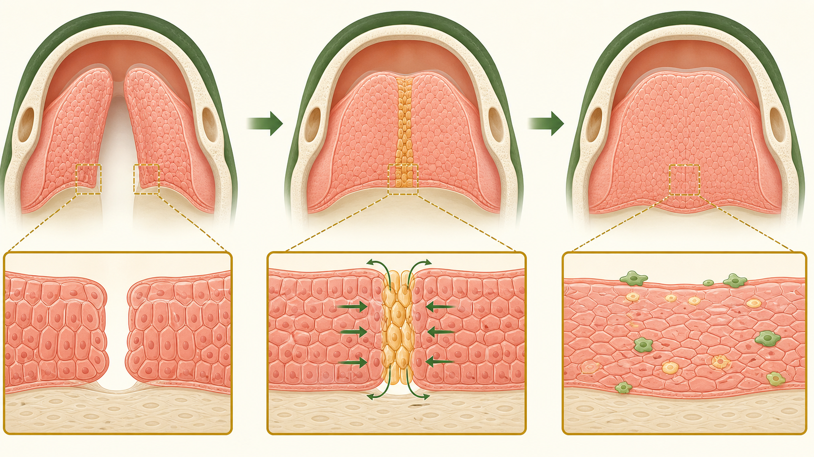
SESSION 6 | HBS | THE MASTER SWITCH
Real biology question: what does TGFB3 help us investigate?
• TGFB3 signaling is a well-studied contributor to palatal fusion and seam remodeling.
• After palatal shelves contact, the medial epithelial seam must be remodeled for a continuous palate to form.
• The question is which step changed: growth, contact, or seam remodeling.
This is a real mechanism. The claim stays matched to the evidence, not to an assumed patient diagnosis.
Real biology: the analogy becomes a research question
8/13

Slide 9
SESSION 6 | HBS | THE MASTER SWITCH
Map the analogy onto the biology
Temporary scaffolding
The medial epithelial seam
Careful removal
Cell remodeling including EMT and programmed cell death
Continuous bridge
A fused, continuous palate
Label transfer: each biology step has an analogy step
9/13

Slide 10
SESSION 6 | HBS | THE MASTER SWITCH
Your team has to make a call
SITUATION
Control palatal shelves contact and then become continuous. In a TGFB3-reduced model, the shelves contact but a persistent epithelial seam remains. Which step has the most direct evidence of failure: shelf growth, shelf contact, or seam remodeling?
Require a claim, the evidence in the situation, and reasoning that uses today's analogy rule.
Concrete decision: evidence has a job to do
10/13

Slide 11
SESSION 6 | HBS | THE MASTER SWITCH
Make the strongest evidence-based decision
Choose seam remodeling. The shelves made contact, so more growth is not the immediate fix. Next we follow the gene-to-protein instruction chain that can affect a cell behavior.
DECISION
Socratic follow-up: Which fact in the scenario made a different answer less defensible?
Decision reveal: defend the conclusion with evidence
11/13

Slide 12
SESSION 6 | HBS | THE MASTER SWITCH
Leave with the idea. Enter with the next question.
TODAY'S EXIT
NEXT UNLOCK
Use the word sculpting to explain fusion. Then ask: what molecular instructions help cells build and remodel at the right time?
Next lesson unlock: From a gene instruction to a cell behavior.
Exit ticket and bridge
12/13

Slide 13
SESSION 6 | HBS | THE MASTER SWITCH
Evidence behind today's lesson
Course connection
PLTW HBS: explain tissue formation and remodeling.
• NIDCR. Cleft Lip & Palate. nidcr.nih.gov/health-info/cleft-lip-palate
• Jin & Ding. Palatal Seam Disintegration. PMC2659566.
Research sources are selected for student-safe, evidence-based framing.
Sources and alignment
13/13

