Slide 1
SESSION 5 | HBS | THE MASTER SWITCH
How Cells Choose What to Become
How can two nearby neural crest cells make different fates from the same DNA?
A cell's fate reflects both its internal state and the cues around it. Developmental signals can instruct, permit, or block a path.
Truth 1: Same DNA can produce different cell types because different genes are active.
Craniofacial Research Track | John Hay Biomedical
1/13

Slide 2
SESSION 5 | HBS | THE MASTER SWITCH
Carry the previous idea forward
Yesterday's takeaway: traveling cells must arrive in the right place before they can build.
Today we use that idea to answer one deeper question.
Bring yesterday forward before adding new details
2/13

Slide 3
SESSION 5 | HBS | THE MASTER SWITCH
Our unit has four truths to return to
1. Cells differentiate
2. Development sculpts
3. Cells move
4. Dysregulation changes outcomes
Truth 1: Same DNA can produce different cell types because different genes are active.
The four durable truths of developmental biology
3/13

Slide 4
SESSION 5 | HBS | THE MASTER SWITCH
Today's take-home
A cell's fate reflects both its internal state and the cues around it. Developmental signals can instruct, permit, or block a path.
Internal state
which genes are available
External cues
signals, neighbors, matrix
Cell fate
more specialized choice
Say this aloud: A cell's fate reflects both its internal state and the cues around it. Developmental signals can instruct, permit, or block a path.
Daily graphical abstract
4/13

Slide 5

SESSION 5 | HBS | THE MASTER SWITCH
Study the gps plus driver
Do not name the biology yet. Describe only what you see.
Analogy picture: observe before explaining
5/13

Slide 6
SESSION 5 | HBS | THE MASTER SWITCH
What does the picture make you notice?
• Which information is inside the car?
• Which information comes from outside the car?
• What could make two cars choose different turns at the same fork?
Teacher move: collect observations first. Delay the biological vocabulary until students state the pattern.
Socratic inquiry: students create the rule
6/13

Slide 7
SESSION 5 | HBS | THE MASTER SWITCH
Turn your observations into rules
• Internal state shapes which options are available.
• External cues supply position-specific information.
• A decision can be instructed, permitted, or blocked.
Now name the analogy. Ask students to defend each rule with a detail from the picture.
Socratic inquiry: name the rule together
7/13

Slide 8
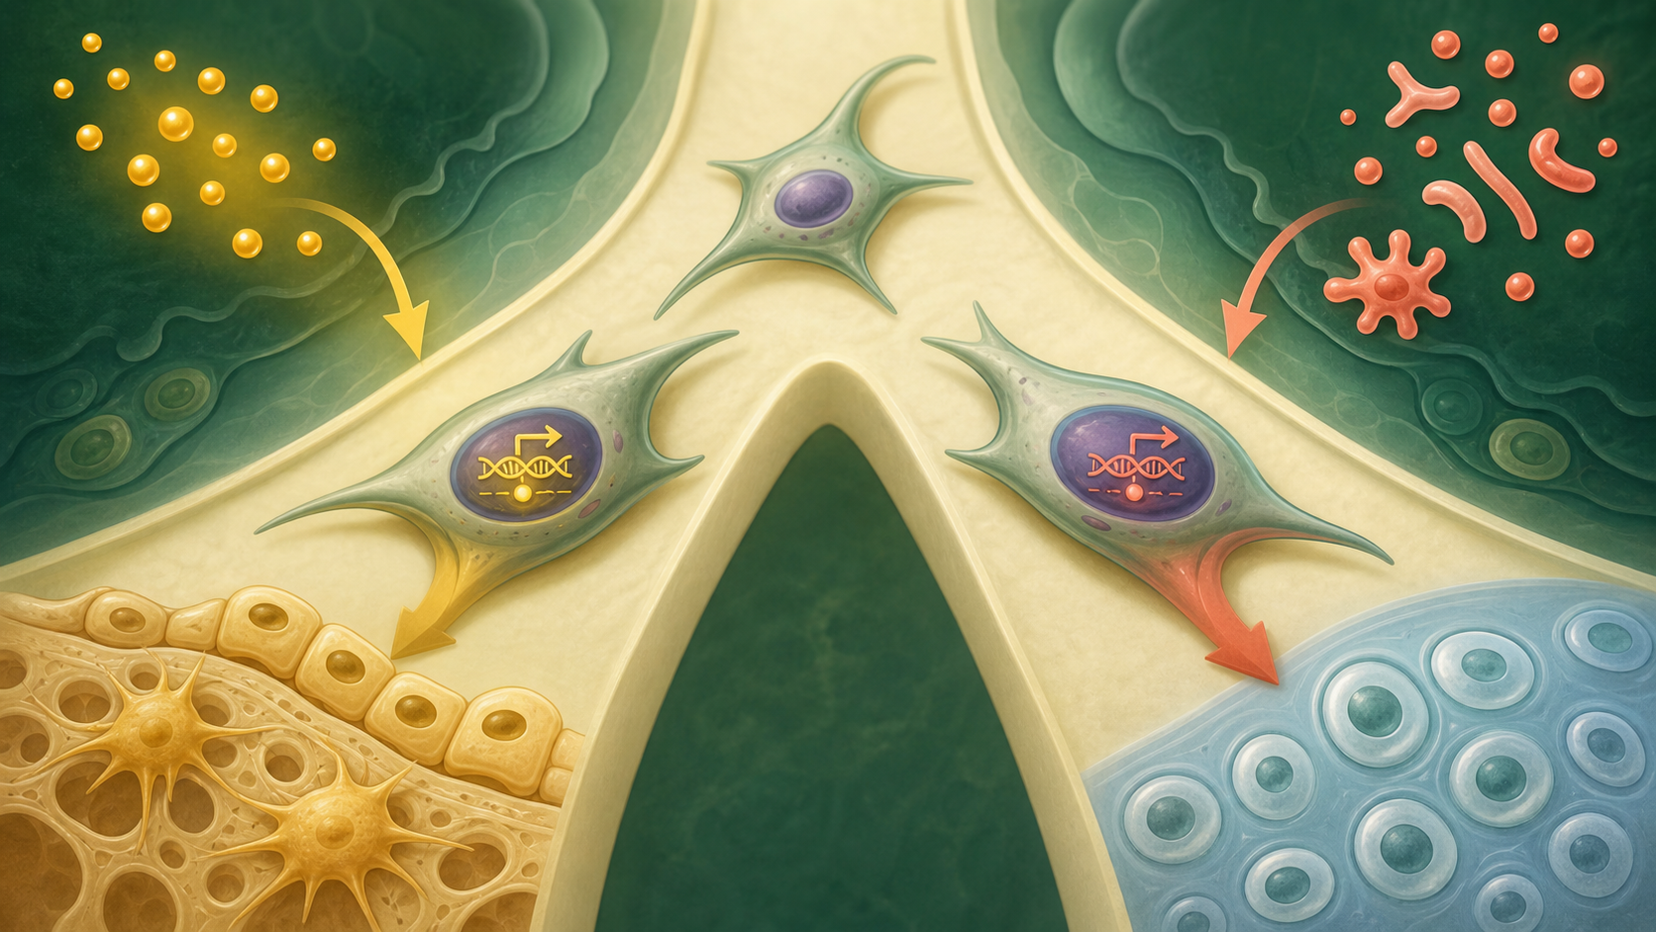
SESSION 5 | HBS | THE MASTER SWITCH
Real biology question: how does WNT/β-catenin change the choice?
• In cranial bone progenitors, canonical WNT/β-catenin signaling is important for osteogenic commitment and suppresses competing cartilage programs.
• RUNX2 and SOX9 help students see that a fate decision uses interacting gene programs, not a magical single switch.
• The key logic remains: cue plus internal state changes the likely path.
This is a real mechanism. The claim stays matched to the evidence, not to an assumed patient diagnosis.
Real biology: the analogy becomes a research question
8/13

Slide 9
SESSION 5 | HBS | THE MASTER SWITCH
Map the analogy onto the biology
GPS map
Internal gene-expression state and cell history
Road signs
External WNT and neighboring-tissue cues
Fork in road
Bone-forming versus cartilage-associated program
Label transfer: each biology step has an analogy step
9/13

Slide 10
SESSION 5 | HBS | THE MASTER SWITCH
Your team has to make a call
SITUATION
Two cranial neural crest cells sit in different positions. Cell A receives strong WNT signaling and can activate RUNX2. Cell B receives little WNT and has high SOX9 activity. Which prediction is best: A. both cells must make bone, B. Cell A is more likely to enter a bone-forming program, C. Cell B proves Mateo has a mutation?
Require a claim, the evidence in the situation, and reasoning that uses today's analogy rule.
Concrete decision: evidence has a job to do
10/13

Slide 11
SESSION 5 | HBS | THE MASTER SWITCH
Make the strongest evidence-based decision
Choose B. It fits the direct cues and internal states without overclaiming. Next we ask how correctly chosen cells become one continuous tissue.
DECISION
Socratic follow-up: Which fact in the scenario made a different answer less defensible?
Decision reveal: defend the conclusion with evidence
11/13

Slide 12
SESSION 5 | HBS | THE MASTER SWITCH
Leave with the idea. Enter with the next question.
TODAY'S EXIT
NEXT UNLOCK
Contrast an instructive cue with a permissive condition in your own words. A chosen fate still does not join tissue. How does a seam disappear?
Next lesson unlock: Development sculpts tissue by building, removing, and remodeling.
Exit ticket and bridge
12/13

Slide 13
SESSION 5 | HBS | THE MASTER SWITCH
Evidence behind today's lesson
Course connection
PLTW HBS: connect cell specialization to gene expression.
• Jin et al. Gene Regulatory Network from Cranial Neural Crest to Osteoblasts. PMC11072871.
• Peters et al. Signals and Switches in Mammalian Neural Crest Differentiation. PMC3552505.
Research sources are selected for student-safe, evidence-based framing.
Sources and alignment
13/13

