Slide 1
SESSION 4 | HBS | THE MASTER SWITCH
The Cells That Build the Face
Which cells fill the facial tissues, and how do they get there?
Cranial neural crest cells are traveling builders. Their route, arrival, and growth help create the facial tissues that later must fuse.
Truth 3: Cells move to form structures.
Craniofacial Research Track | John Hay Biomedical
1/13

Slide 2
SESSION 4 | HBS | THE MASTER SWITCH
Carry the previous idea forward
Yesterday's takeaway: a failed fusion can begin long before two edges try to join.
Today we use that idea to answer one deeper question.
Bring yesterday forward before adding new details
2/13

Slide 3
SESSION 4 | HBS | THE MASTER SWITCH
Our unit has four truths to return to
1. Cells differentiate
2. Development sculpts
3. Cells move
4. Dysregulation changes outcomes
Truth 3: Cells move to form structures.
The four durable truths of developmental biology
3/13

Slide 4
SESSION 4 | HBS | THE MASTER SWITCH
Today's take-home
Cranial neural crest cells are traveling builders. Their route, arrival, and growth help create the facial tissues that later must fuse.
Leave the neural folds
Travel in organized streams
Populate and build facial tissue
Say this aloud: Cranial neural crest cells are traveling builders. Their route, arrival, and growth help create the facial tissues that later must fuse.
Daily graphical abstract
4/13

Slide 5
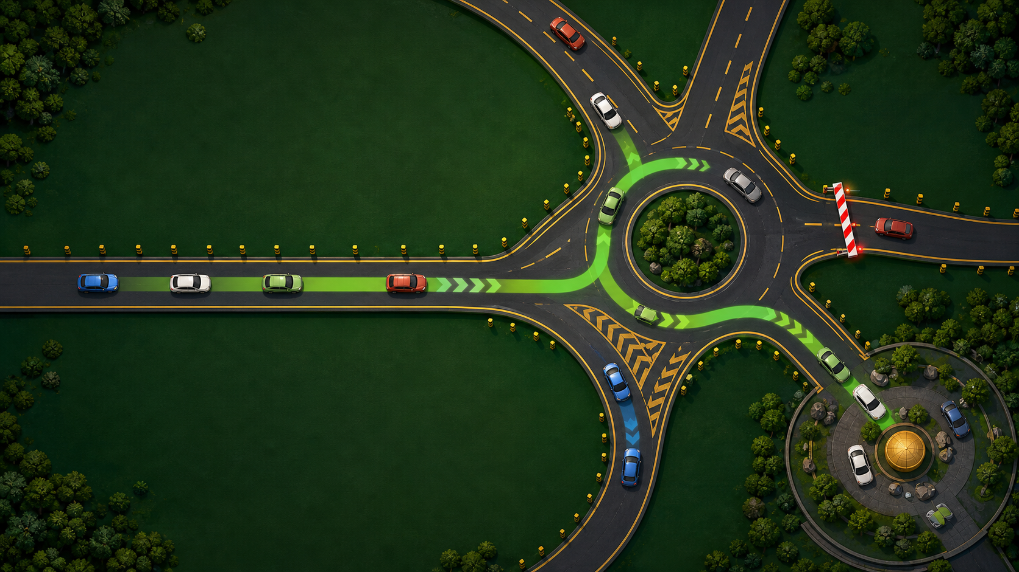
SESSION 4 | HBS | THE MASTER SWITCH
Study the traffic system
Do not name the biology yet. Describe only what you see.
Analogy picture: observe before explaining
5/13

Slide 6
SESSION 4 | HBS | THE MASTER SWITCH
What does the picture make you notice?
• What guides a car to the intended destination?
• What happens when a lane is blocked or an exit is missed?
• Why can one wrong route change the whole map downstream?
Teacher move: collect observations first. Delay the biological vocabulary until students state the pattern.
Socratic inquiry: students create the rule
6/13

Slide 7
SESSION 4 | HBS | THE MASTER SWITCH
Turn your observations into rules
• Cells need routes, directional cues, and boundaries.
• Arrival is not enough. Cells must arrive at the correct destination in sufficient numbers.
• A routing error can become a tissue-size or shape problem.
Now name the analogy. Ask students to defend each rule with a detail from the picture.
Socratic inquiry: name the rule together
7/13

Slide 8
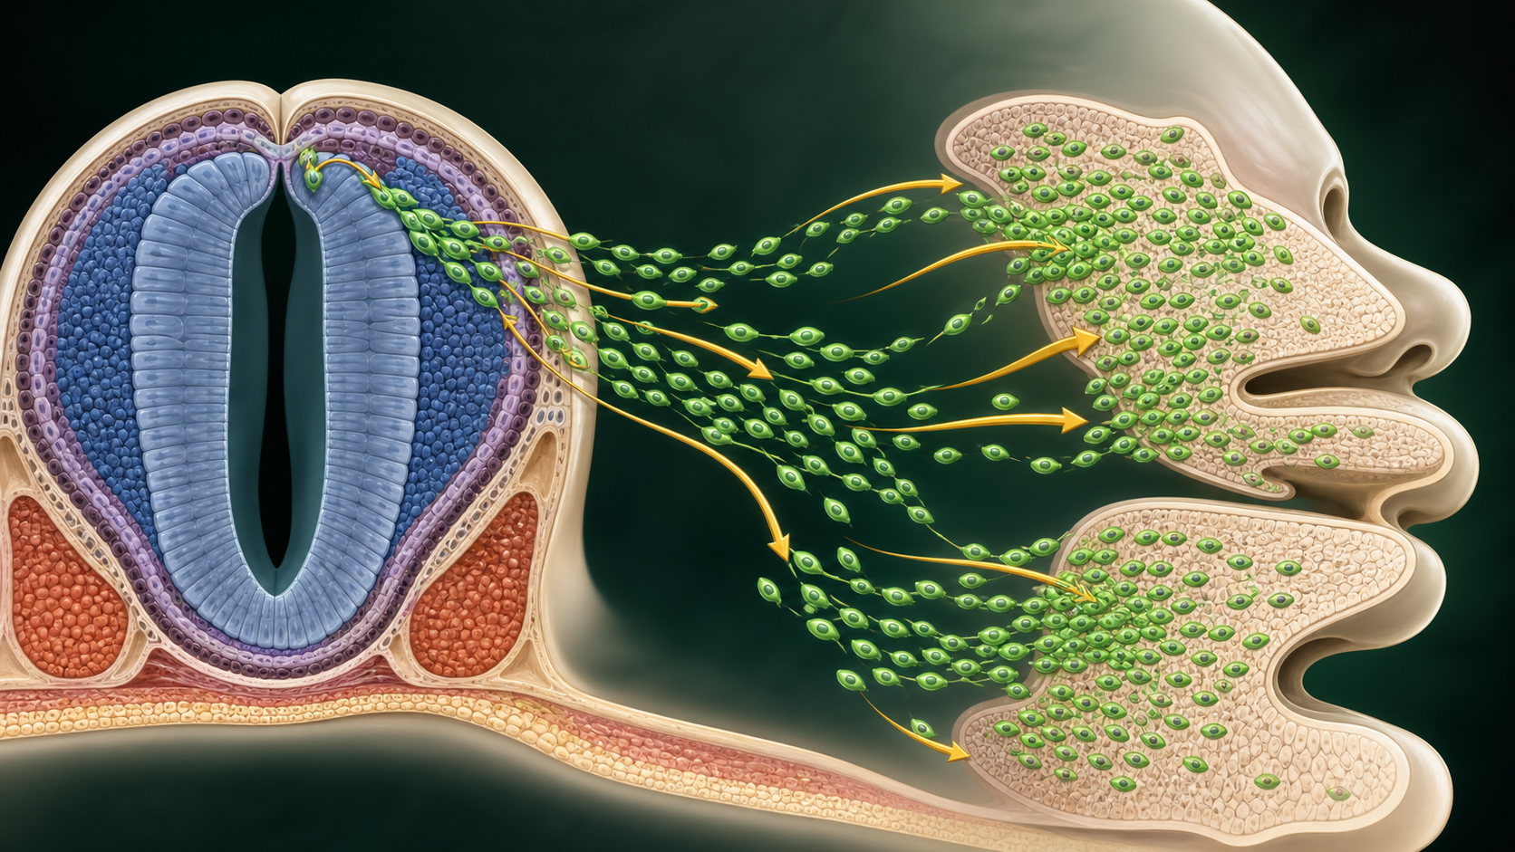
SESSION 4 | HBS | THE MASTER SWITCH
Real biology question: what does a neural crest marker let us see?
• Researchers use neural crest markers such as SOX10 to follow migratory cell populations in model embryos.
• A marker can show where a population travels. It does not alone prove what caused a route to change.
• That distinction lets students reason from direct evidence to the next test.
This is a real mechanism. The claim stays matched to the evidence, not to an assumed patient diagnosis.
Real biology: the analogy becomes a research question
8/13

Slide 9
SESSION 4 | HBS | THE MASTER SWITCH
Map the analogy onto the biology
Cars
Cranial neural crest cells
Road and lane barriers
Extracellular matrix pathways and boundaries
Traffic signals
Directional cues from nearby tissues
Label transfer: each biology step has an analogy step
9/13

Slide 10
SESSION 4 | HBS | THE MASTER SWITCH
Your team has to make a call
SITUATION
A model embryo has a smaller maxillary prominence. A neural crest marker shows fewer labeled cells arriving there, while the cells that arrive still differentiate normally. What is the most direct explanation to test next: a migration route problem, a bone-fate problem, or a final diagnosis?
Require a claim, the evidence in the situation, and reasoning that uses today's analogy rule.
Concrete decision: evidence has a job to do
10/13

Slide 11
SESSION 4 | HBS | THE MASTER SWITCH
Make the strongest evidence-based decision
Test migration route and arrival first. The evidence points to a traffic problem before a fate problem. Next we ask how arrived cells choose a fate.
DECISION
Socratic follow-up: Which fact in the scenario made a different answer less defensible?
Decision reveal: defend the conclusion with evidence
11/13

Slide 12
SESSION 4 | HBS | THE MASTER SWITCH
Leave with the idea. Enter with the next question.
TODAY'S EXIT
NEXT UNLOCK
Explain how a problem in migration could later look like a fusion problem. Once a crest cell arrives, what tells it what to become?
Next lesson unlock: How cells with the same DNA make different choices.
Exit ticket and bridge
12/13

Slide 13
SESSION 4 | HBS | THE MASTER SWITCH
Evidence behind today's lesson
Course connection
PLTW HBS: examine how cells form tissues during development.
• Cordero et al. Cranial Neural Crest Cells on the Move. PMC3039913.
• Jin et al. Gene Regulatory Network from Cranial Neural Crest to Osteoblasts. PMC11072871.
Research sources are selected for student-safe, evidence-based framing.
Sources and alignment
13/13

