Slide 1
SESSION 3 | PBS | THE CASE OPENS
A Cleft Marks a Step That Did Not Finish
What does a cleft tell us about the normal developmental process?
A cleft is not a missing instruction by itself. It is evidence that a specific developmental join did not finish in its critical window.
Truth 4: A birth difference can be traced to disrupted developmental processes.
Craniofacial Research Track | John Hay Biomedical
1/13

Slide 2
SESSION 3 | PBS | THE CASE OPENS
Carry the previous idea forward
Yesterday's takeaway: tissues must meet and join on time.
Today we use that idea to answer one deeper question.
Bring yesterday forward before adding new details
2/13

Slide 3
SESSION 3 | PBS | THE CASE OPENS
Our unit has four truths to return to
1. Cells differentiate
2. Development sculpts
3. Cells move
4. Dysregulation changes outcomes
Truth 4: A birth difference can be traced to disrupted developmental processes.
The four durable truths of developmental biology
3/13

Slide 4
SESSION 3 | PBS | THE CASE OPENS
Today's take-home
A cleft is not a missing instruction by itself. It is evidence that a specific developmental join did not finish in its critical window.
Edges grow
Edges meet
Fusion completes or an opening remains
Say this aloud: A cleft is not a missing instruction by itself. It is evidence that a specific developmental join did not finish in its critical window.
Daily graphical abstract
4/13

Slide 5
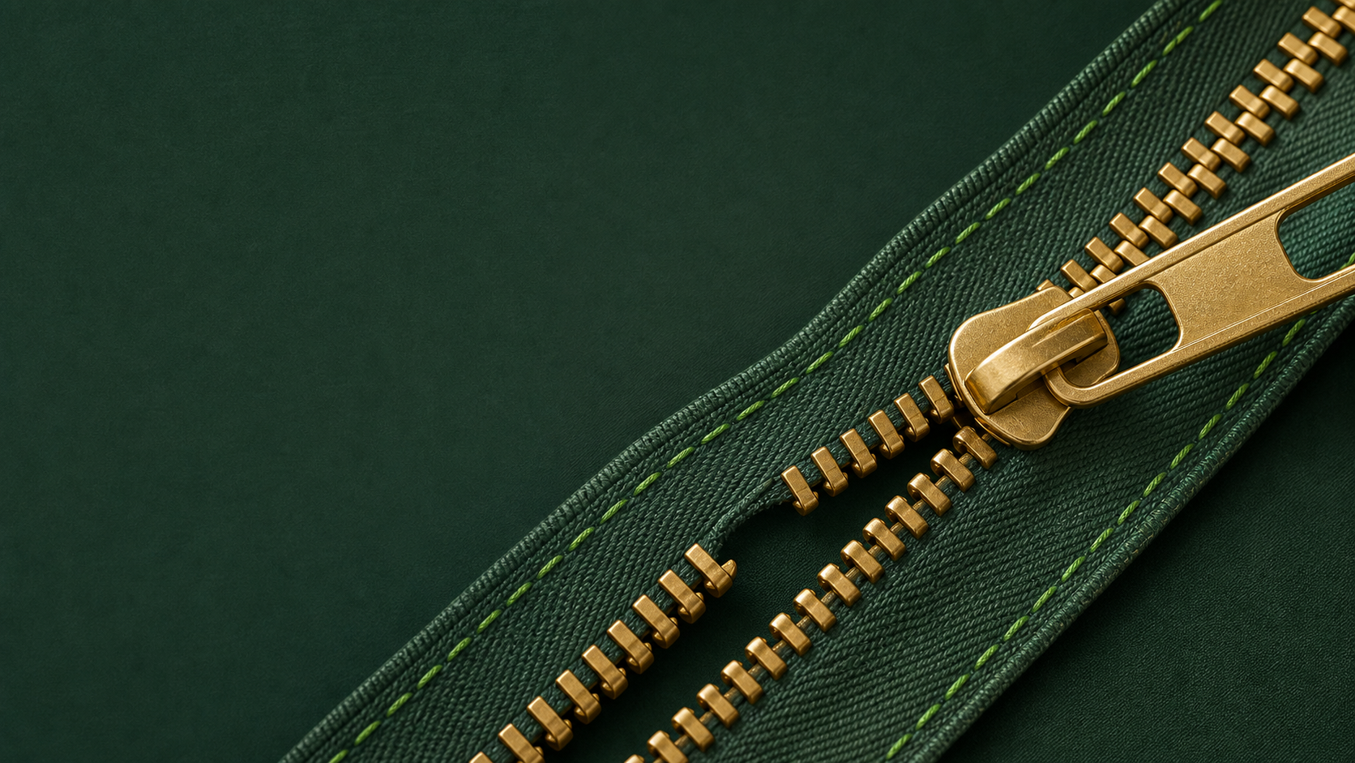
SESSION 3 | PBS | THE CASE OPENS
Study the a zipper is not closed because one tooth did not engage at the right time. the opening is a clue to the step that failed.
Do not name the biology yet. Describe only what you see.
Analogy picture: observe before explaining
5/13

Slide 6
SESSION 3 | PBS | THE CASE OPENS
What does the picture make you notice?
• Which parts must meet for the zipper to close?
• What does the remaining opening tell you?
• Could more pulling fix every kind of zipper failure?
Teacher move: collect observations first. Delay the biological vocabulary until students state the pattern.
Socratic inquiry: students create the rule
6/13

Slide 7
SESSION 3 | PBS | THE CASE OPENS
Turn your observations into rules
• A completed join requires matching edges.
• The opening records that the joining process did not finish.
• Different upstream problems can leave a similar opening.
Now name the analogy. Ask students to defend each rule with a detail from the picture.
Socratic inquiry: name the rule together
7/13

Slide 8
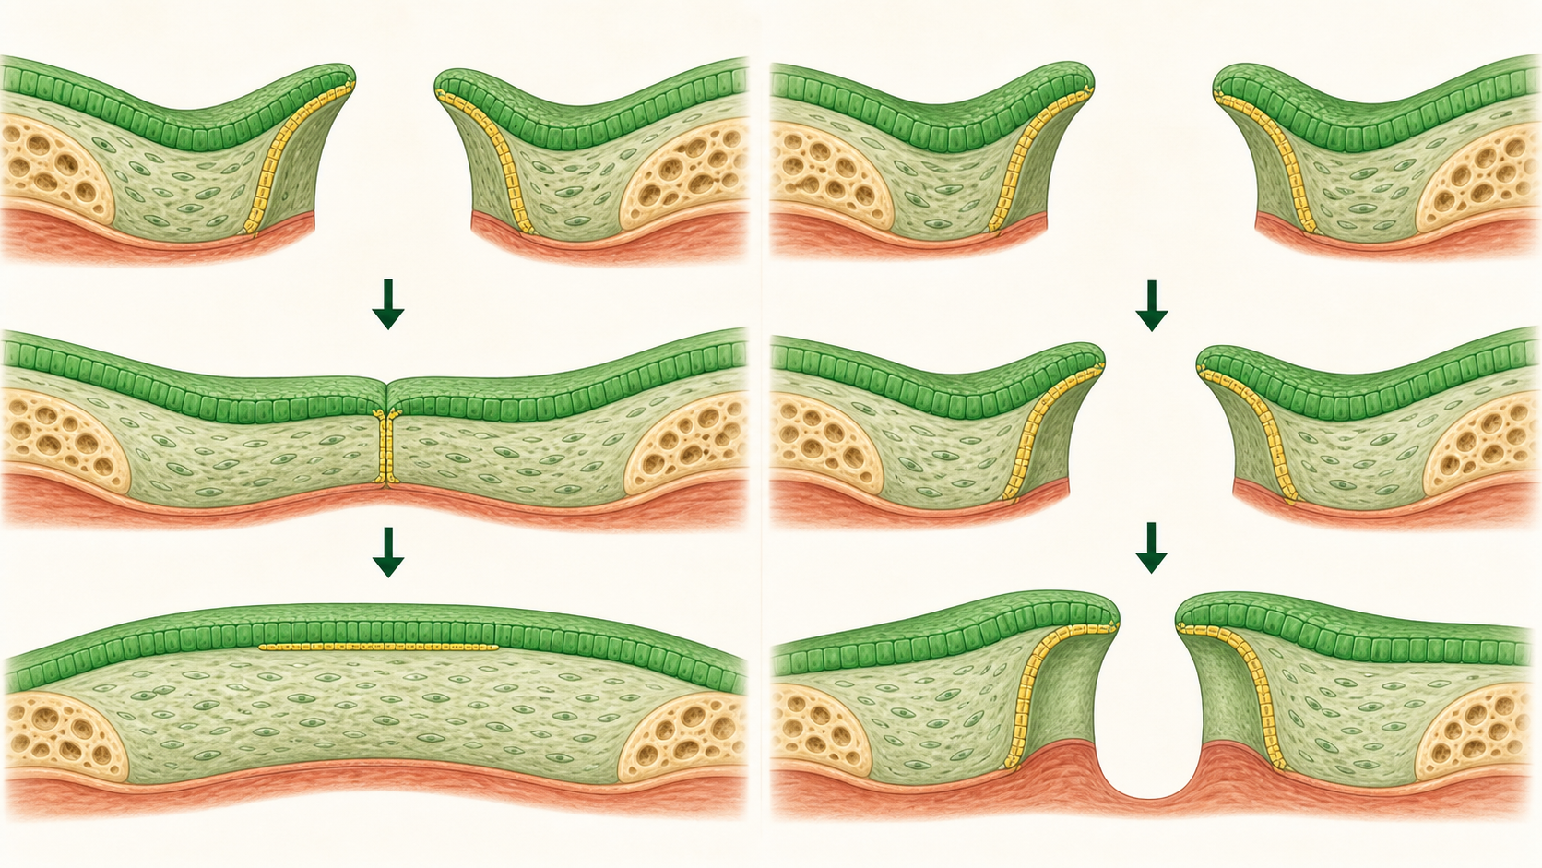
SESSION 3 | PBS | THE CASE OPENS
Real biology question: how can IRF6 affect a join?
• IRF6 helps regulate epithelial and periderm cell behaviors important for normal lip and palate development.
• In experimental models, altered IRF6 can disrupt the tissue conditions needed for normal fusion.
• The gene example sharpens a process question. It does not convert every cleft into a single-gene story.
This is a real mechanism. The claim stays matched to the evidence, not to an assumed patient diagnosis.
Real biology: the analogy becomes a research question
8/13

Slide 9
SESSION 3 | PBS | THE CASE OPENS
Map the analogy onto the biology
Zipper teeth
Cells along two tissue edges
Zipper pull
Signals coordinating the joining process
Opening
A cleft after fusion does not complete
Label transfer: each biology step has an analogy step
9/13

Slide 10
SESSION 3 | PBS | THE CASE OPENS
Your team has to make a call
SITUATION
In two model embryos, the tissue edges reach each other. In one, the edges join. In the other, an epithelial layer sticks in the wrong place and the join cannot finish. Which process needs investigation first: migration, seam behavior, or final diagnosis?
Require a claim, the evidence in the situation, and reasoning that uses today's analogy rule.
Concrete decision: evidence has a job to do
10/13

Slide 11
SESSION 3 | PBS | THE CASE OPENS
Make the strongest evidence-based decision
Investigate seam behavior. The edges arrived, so the concrete failure is in the joining process. Next we trace the cells that built those edges.
DECISION
Socratic follow-up: Which fact in the scenario made a different answer less defensible?
Decision reveal: defend the conclusion with evidence
11/13

Slide 12
SESSION 3 | PBS | THE CASE OPENS
Leave with the idea. Enter with the next question.
TODAY'S EXIT
NEXT UNLOCK
Name one process that could interrupt fusion. Then ask: which traveling cells build the tissues that are supposed to meet?
Next lesson unlock: The migrating cells that build the face.
Exit ticket and bridge
12/13

Slide 13
SESSION 3 | PBS | THE CASE OPENS
Evidence behind today's lesson
Course connection
PLTW PBS: connect structure, process, and evidence.
• NIDCR. Cleft Lip & Palate. nidcr.nih.gov/health-info/cleft-lip-palate
• Cordero et al. Cranial Neural Crest Cells on the Move. PMC3039913.
Research sources are selected for student-safe, evidence-based framing.
Sources and alignment
13/13

