Slide 1
SESSION 2 | PBS | THE CASE OPENS
How a Face Is Built
If we could film development, what would we see from weeks 4 to 12?
The face is assembled when growing tissues move, meet, and join during brief windows of time.
Truths 2 and 3: Development sculpts and moves tissue on a schedule.
Craniofacial Research Track | John Hay Biomedical
1/13

Slide 2
SESSION 2 | PBS | THE CASE OPENS
Carry the previous idea forward
Yesterday's question: What normal building step did not finish?
Today we use that idea to answer one deeper question.
Bring yesterday forward before adding new details
2/13

Slide 3
SESSION 2 | PBS | THE CASE OPENS
Our unit has four truths to return to
1. Cells differentiate
2. Development sculpts
3. Cells move
4. Dysregulation changes outcomes
Truths 2 and 3: Development sculpts and moves tissue on a schedule.
The four durable truths of developmental biology
3/13

Slide 4
SESSION 2 | PBS | THE CASE OPENS
Today's take-home
The face is assembled when growing tissues move, meet, and join during brief windows of time.
Grow toward the midline
Meet on time
Join into one structure
Say this aloud: The face is assembled when growing tissues move, meet, and join during brief windows of time.
Daily graphical abstract
4/13

Slide 5

SESSION 2 | PBS | THE CASE OPENS
Study the a bridge build
Do not name the biology yet. Describe only what you see.
Analogy picture: observe before explaining
5/13

Slide 6
SESSION 2 | PBS | THE CASE OPENS
What does the picture make you notice?
• What must happen before this bridge becomes one crossing?
• What could make the halves miss even if both crews are working?
• Which detail shows that timing matters?
Teacher move: collect observations first. Delay the biological vocabulary until students state the pattern.
Socratic inquiry: students create the rule
6/13

Slide 7
SESSION 2 | PBS | THE CASE OPENS
Turn your observations into rules
• Two structures must arrive at the same place.
• They must arrive within the same window.
• The visible gap is evidence of a failed connection, not the full explanation.
Now name the analogy. Ask students to defend each rule with a detail from the picture.
Socratic inquiry: name the rule together
7/13

Slide 8
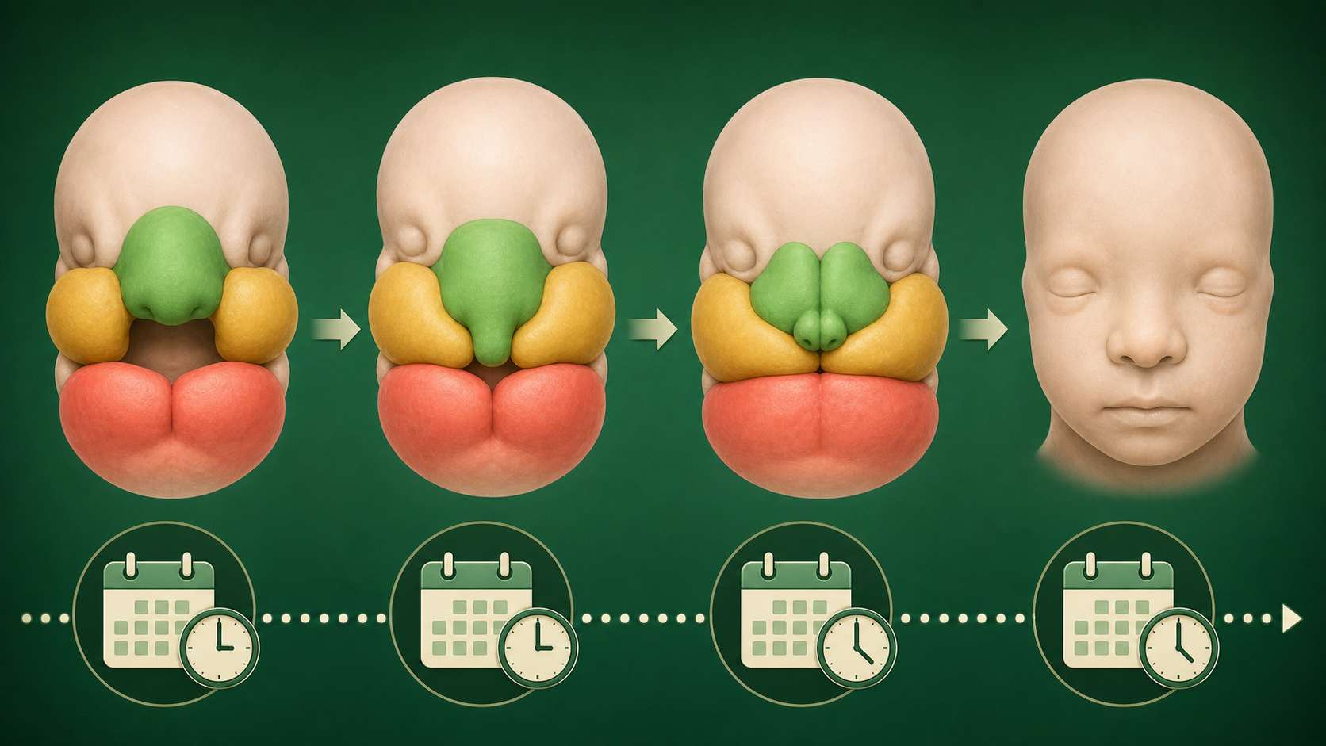
SESSION 2 | PBS | THE CASE OPENS
Real biology question: when does a WNT9B-linked signal matter?
• WNT9B is one gene linked to pathways that help pattern the developing face.
• A team measures a reporter signal before and during the time facial tissues approach one another.
• The useful question is not whether WNT9B is 'good' or 'bad,' but whether position and timing line up with the building step.
This is a real mechanism. The claim stays matched to the evidence, not to an assumed patient diagnosis.
Real biology: the analogy becomes a research question
8/13

Slide 9
SESSION 2 | PBS | THE CASE OPENS
Map the analogy onto the biology
Bridge half
A growing facial tissue prominence
Construction schedule
A critical developmental window
Unclosed gap
A fusion step that did not finish
Label transfer: each biology step has an analogy step
9/13

Slide 10
SESSION 2 | PBS | THE CASE OPENS
Your team has to make a call
SITUATION
At the expected lip-fusion window, two facial outgrowths in a model are growing but remain separated. The WNT9B-associated signal is present only after the usual contact window. What should the team test next: tissue size, timing of the signal, or a patient diagnosis?
Require a claim, the evidence in the situation, and reasoning that uses today's analogy rule.
Concrete decision: evidence has a job to do
10/13

Slide 11
SESSION 2 | PBS | THE CASE OPENS
Make the strongest evidence-based decision
Test tissue size and signal timing first. The immediate mystery is a missed building window. Next we name what an unclosed connection is telling us.
DECISION
Socratic follow-up: Which fact in the scenario made a different answer less defensible?
Decision reveal: defend the conclusion with evidence
11/13

Slide 12
SESSION 2 | PBS | THE CASE OPENS
Leave with the idea. Enter with the next question.
TODAY'S EXIT
NEXT UNLOCK
Explain why growth alone is not enough to build the face. If edges fail to join, what do we call the opening that remains?
Next lesson unlock: A cleft is evidence of an interrupted fusion step.
Exit ticket and bridge
12/13

Slide 13
SESSION 2 | PBS | THE CASE OPENS
Evidence behind today's lesson
Course connection
PLTW PBS: relate body structures to development.
• NIDCR. Cleft Lip & Palate. nidcr.nih.gov/health-info/cleft-lip-palate
• Cordero et al. Cranial Neural Crest Cells on the Move. PMC3039913.
Research sources are selected for student-safe, evidence-based framing.
Sources and alignment
13/13

