Slide 1
SESSION 1 | PBS | THE CASE OPENS
Meet Mateo
What questions would a research lab ask first?
A patient story becomes science when we turn what we notice into questions we can investigate.
Truth 4: Developmental processes can go wrong.
Craniofacial Research Track | John Hay Biomedical
1/13

Slide 2
SESSION 1 | PBS | THE CASE OPENS
Carry the previous idea forward
Start here: careful observation is the first scientific tool.
Today we use that idea to answer one deeper question.
Bring yesterday forward before adding new details
2/13

Slide 3
SESSION 1 | PBS | THE CASE OPENS
Our unit has four truths to return to
1. Cells differentiate
2. Development sculpts
3. Cells move
4. Dysregulation changes outcomes
Truth 4: Developmental processes can go wrong.
The four durable truths of developmental biology
3/13

Slide 4
SESSION 1 | PBS | THE CASE OPENS
Today's take-home
A patient story becomes science when we turn what we notice into questions we can investigate.
Observe
Name what is unknown
Ask a testable question
Say this aloud: A patient story becomes science when we turn what we notice into questions we can investigate.
Daily graphical abstract
4/13

Slide 5
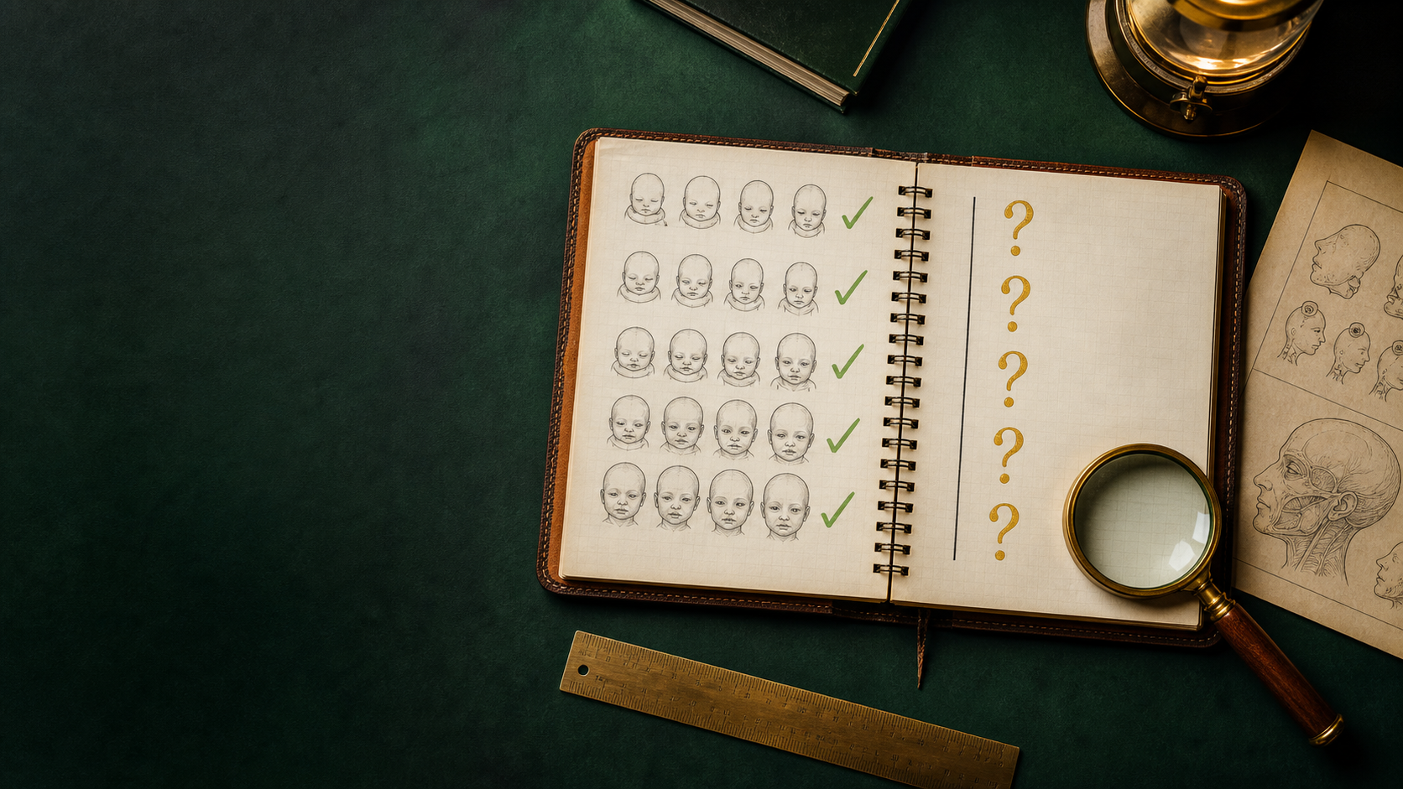
SESSION 1 | PBS | THE CASE OPENS
Study the detective notebook
Do not name the biology yet. Describe only what you see.
Analogy picture: observe before explaining
5/13

Slide 6
SESSION 1 | PBS | THE CASE OPENS
What does the picture make you notice?
• What on this page counts as an observation?
• Which marks show uncertainty rather than a conclusion?
• Which question could evidence actually help answer?
Teacher move: collect observations first. Delay the biological vocabulary until students state the pattern.
Socratic inquiry: students create the rule
6/13

Slide 7
SESSION 1 | PBS | THE CASE OPENS
Turn your observations into rules
• Record what is present before explaining it.
• Separate a clue from the story you tell about the clue.
• Turn an unknown into a question a study could answer.
Now name the analogy. Ask students to defend each rule with a detail from the picture.
Socratic inquiry: name the rule together
7/13

Slide 8
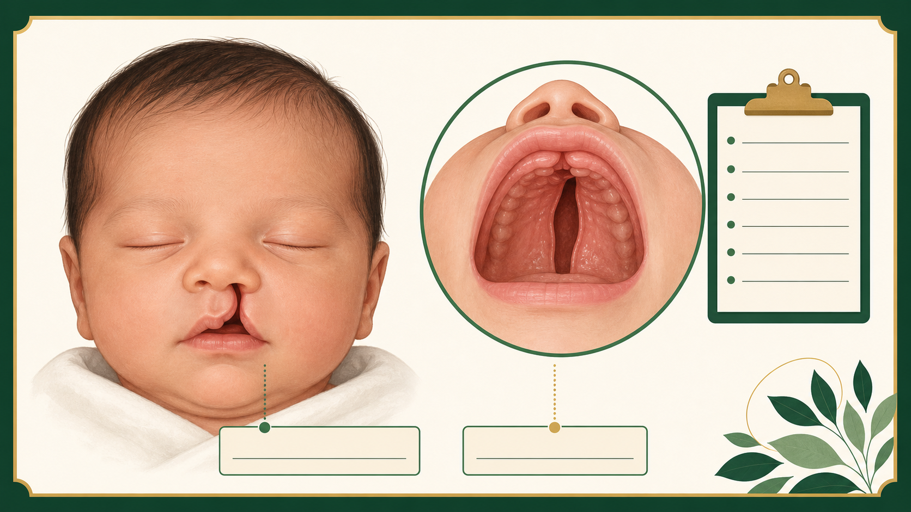
SESSION 1 | PBS | THE CASE OPENS
Real biology question: what does IRF6 help us ask?
• IRF6 is a gene whose protein helps epithelial cells in developing lip and palate tissue do their job.
• A research team sees altered IRF6 activity in a model with failed fusion.
• The evidence supports a question about cell behavior. It does not yet diagnose Mateo.
This is a real mechanism. The claim stays matched to the evidence, not to an assumed patient diagnosis.
Real biology: the analogy becomes a research question
8/13

Slide 9
SESSION 1 | PBS | THE CASE OPENS
Map the analogy onto the biology
Notebook observation
Where and when IRF6 activity is measured
Question mark
What cell behavior changes when activity is reduced?
Evidence column
A model, comparison, and reproducible measurement
Label transfer: each biology step has an analogy step
9/13

Slide 10
SESSION 1 | PBS | THE CASE OPENS
Your team has to make a call
SITUATION
A lab can spend its first week on one question. Choose the strongest one: A. Does Mateo's cleft prove IRF6 is changed? B. In a model, does lowering IRF6 alter epithelial behavior during the fusion window? C. Is IRF6 a bad gene?
Require a claim, the evidence in the situation, and reasoning that uses today's analogy rule.
Concrete decision: evidence has a job to do
10/13

Slide 11
SESSION 1 | PBS | THE CASE OPENS
Make the strongest evidence-based decision
Choose B. It names a testable condition, a measurable cell behavior, and a time window. Tomorrow we ask where the tissue edges normally meet.
DECISION
Socratic follow-up: Which fact in the scenario made a different answer less defensible?
Decision reveal: defend the conclusion with evidence
11/13

Slide 12
SESSION 1 | PBS | THE CASE OPENS
Leave with the idea. Enter with the next question.
TODAY'S EXIT
NEXT UNLOCK
Turn one observation into one testable question. Then ask: if we could watch development, what would we see?
Next lesson unlock: How a face is built on a schedule.
Exit ticket and bridge
12/13

Slide 13
SESSION 1 | PBS | THE CASE OPENS
Evidence behind today's lesson
Course connection
PLTW PBS: turn observations into testable questions.
• NIDCR. Cleft Lip & Palate. nidcr.nih.gov/health-info/cleft-lip-palate
• Cordero et al. Cranial Neural Crest Cells on the Move. PMC3039913.
Research sources are selected for student-safe, evidence-based framing.
Sources and alignment
13/13

